Slide 1
Spring Repositories
Creating Entities & Generating our Database

Slide 2
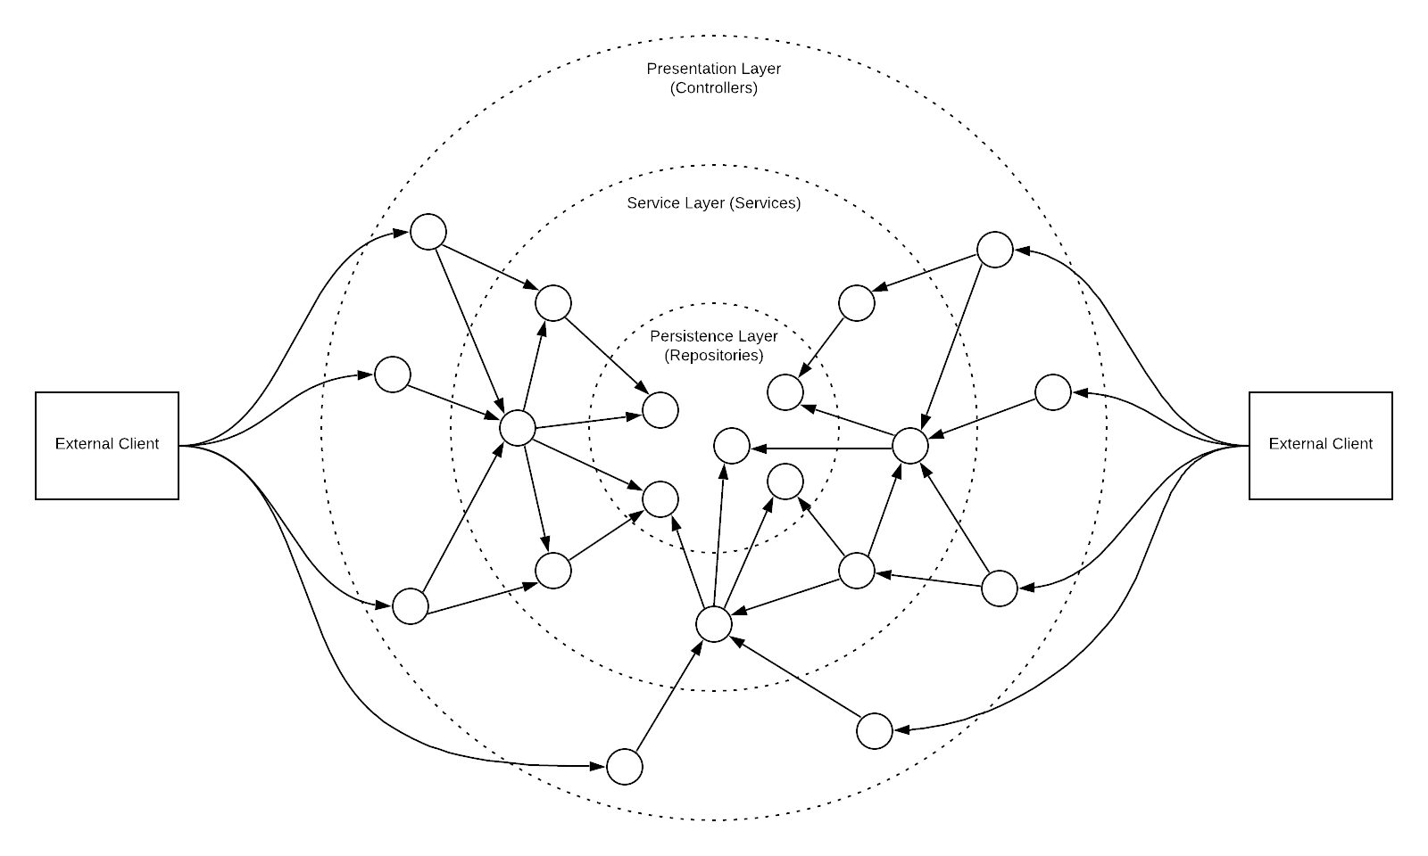
Onion Architecture

Slide 3
Our Data Model
Customer
Order
Lemonade
id
name
phoneNumber
id
total
id
lemonJuice
water
sugar
iceCubes
price
LemonadeStand
id
name

Slide 4
Making JPA Generate our database and print the SQL it uses to the console
spring.jpa.hibernate.ddl-auto
sping.jpa.properties.hibernate.show_sql=true
spring.jpa.properties.hibernate.use_sql_comments=true
spring.jpa.properties.hibernate.format_sql=true

